Slide 1

KCS056 APPLICATION OF
SOFT COMPUTING
UNIT-2
Prepared By- MR. Ashish Tiwari
ASSISTANT PROFESSOR
DEPARTMENT OF COMPUTER SCIENCE ENGINEERING
UNITED COLLEGE OF ENGG. & RESEARCH, PRAYAGRAJ

Slide 2
Unit -2
Neural Networks-II (Back Propagation Network
Back-Propagation Network, topics : Background, what is back-prop network ? learning AND function, simple learning machines – Error measure, perceptron model Perceptron learning rule, Hidden Layer, Back-Propagation Learning : learning by example, single layer artificial neural network multi-layer feed- forward back-propagation network, computation in input, hidden and output layers, error calculation. Back-propagation algorithm for training network - basic loop structure, step-by-step procedure, numerical example. factors affecting back propagation training, applications.

Slide 3
LECTURE - 6

Slide 4
Outlines of Today's Lecture
Introduction
Historical Background
what is back-prop network ?
Back propagation algorithm
Limitations and improvements
What Are Artificial Neural Networks and Deep Neural Networks?
Questions and Answers

Slide 5
Introduction
Artificial Neural Networks are crude attempts to model the highly massive parallel and distributed processing we believe takes place in the brain.
Back propagation, an abbreviation for "backward propagation of errors", is a common method of training artificial neural networks used in conjunction with an optimization method such as gradient descent.
The method calculates the gradient of a loss function with respect to all the weights in the network.
The gradient is fed to the optimization method which in turn uses it to update the weights, in an attempt to minimize the loss function.

Slide 6
Historical Background
In 1969 a method for learning in multi-layer network, Backpropagation, was invented by Bryson and Ho.
The Backpropagation algorithm is a sensible approach for dividing the contribution of each weight.
Works basically the same as perceptrons
Backpropagation Learning Principles: Hidden Layers and Gradients
There are two differences for the updating rule :differences for the updating rule :
The activation of the hidden unit is used instead of activation of the input value. activation of the input value.
The rule contains a term for the gradient of the activation function.
Technically speaking, backpropagation is used to calculate the gradient of the error of the network with respect to the network's modifiable weights.

Slide 7
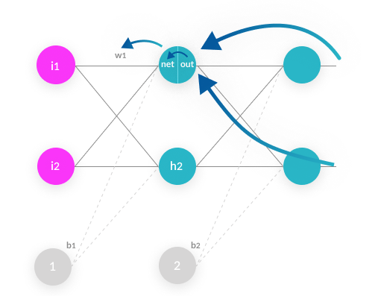
What is backpropagation?
Backpropagation is an algorithm commonly used to train neural networks. When the neural network is initialized, weights are set for its individual elements, called neurons.
Inputs are loaded, they are passed through the network of neurons, and the network provides an output for each one, given the initial weights.
Backpropagation helps to adjust the weights of the neurons so that the result comes closer and closer to the known

Slide 8
Backpropagation algorithm is probably the most fundamental building block in a neural network. It was first introduced in 1960s and almost 30 years later (1989) popularized by Rumelhart, Hinton and Williams in a paper called “Learning representations by back-propagating errors”. Backpropagation is a method to calculate the gradient of the loss function with respect to the weights in an artificial neural network.
It is commonly used as a part of algorithms that optimize the performance of the network by adjusting the weights, for example in the gradient descent algorithm.
Back-propagation, short for "backward propagation of errors," is an algorithm for supervised learning of artificial neural networks using gradient descent.
Given an artificial neural network and an error function, the method calculates the gradient of the error function with respect to the neural network's weights.
Nevertheless it is still a very widely used and a very efficient method for training neural networks. Specialized hardware is being developed these days to perform backpropagation even more efficiently.

Slide 9
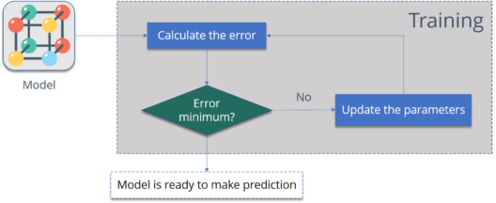
Why We Need Backpropagation?
While designing a Neural Network, in the beginning, we initialize weights with some random values or any variable for that fact.
we need to train our model.
One way to train our model is called as Backpropagation. Consider the diagram below:

Slide 10
Calculate the error – How far is your model output from the actual output.
Minimum Error – Check whether the error is minimized or not.
Update the parameters – If the error is huge then, update the parameters (weights and biases). After that again check the error. Repeat the process until the error becomes minimum.
Model is ready to make a prediction – Once the error becomes minimum, you can feed some inputs to your model and it will produce the output.

Slide 11
Back propagation Algorithm
The back propagation learning algorithm can be divided into two phases:
Phase 1: Propagation
Forward propagation of a training pattern's input through the neural network in order to generate the propagation's output activations.
Backward propagation of the propagation's output activations through the neural network using the training pattern target in order to generate the deltas (the difference between the input and output values) of all output and hidden neurons.
Phase 2: Weight update
Multiply its output delta and input activation to get the gradient of the weight.
Subtract a ratio (percentage) of the gradient from the weight.

Slide 12
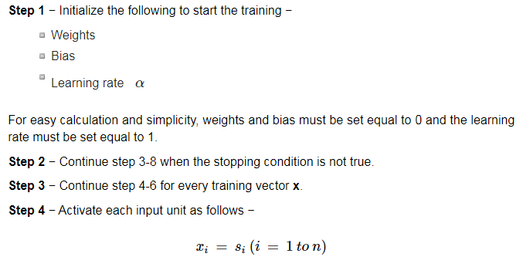

Slide 13
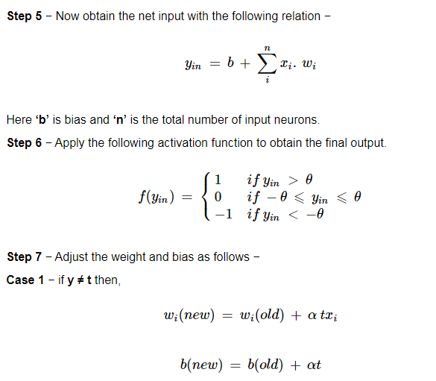

Slide 14
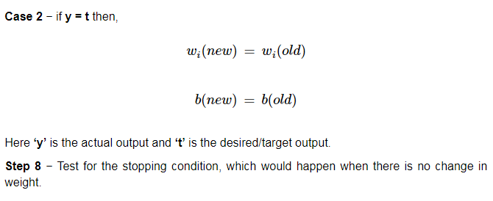

Slide 15
Backpropagation Network training
1. Initialize network with random weights
2. For all training cases (called examples):
a. Present training inputs to network and calculate output
b. For all layers (starting with output layer, back to input layer):
i. Compare network output with correct output
(error function)
ii. Adapt weights in current layer
This is what you want

Slide 16
Backpropagation Learning Details
Method for learning weights in feed-forward (FF) nets
Can’t use Perceptron Learning Rule
no teacher values are possible for hidden units
Use gradient descent to minimize the error
propagate deltas to adjust for errors
backward from outputs
to hidden layers
to inputs
forward
backward

Slide 17
Backpropagation Algorithm – Main Idea – error in hidden layers
The ideas of the algorithm can be summarized as follows :
Computes the error term for the output units using the
observed error.
2. From output layer, repeat
propagating the error term back to the previous layer and
updating the weights between the two layers
until the earliest hidden layer is reached.

Slide 18
Backpropagation Algorithm
Initialize weights (typically random!)
Keep doing epochs
For each example e in training set do
forward pass to compute
O = neural-net-output(network,e)
miss = (T-O) at each output unit
backward pass to calculate deltas to weights
update all weights
end
until tuning set error stops improving
Forward pass explained earlier
Backward pass explained in next slide

Slide 19
Backward Pass
Compute deltas to weights
from hidden layer
to output layer
Without changing any weights (yet), compute the actual contributions
within the hidden layer(s)
and compute deltas

Slide 20
Gradient Descent
Think of the N weights as a point in an N-dimensional space
Add a dimension for the observed error
Try to minimize your position on the “error surface”

Slide 21
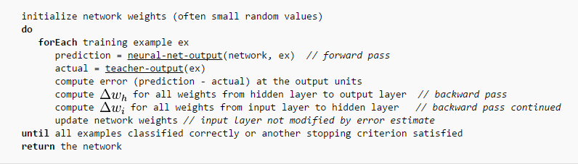
Back propagation Algorithm (contd.)

Slide 22
What is gradient descent algorithm??
Back propagation calculates the gradient of the error of the network regarding the network's modifiable weights.
This gradient is almost always used in a simple stochastic gradient descent algorithm to find weights that minimize the error.

Slide 23
Learning Rates
Different learning rates affect the performance of a neural network significantly.
Optimal Learning Rate:
Leads to the error minimum in one learning step.

Slide 24
Limitations of the back propagation algorithm
It is not guaranteed to find global minimum of the error function. It may get trapped in a local minima,
Improvements,
Add momentum.
Use stochastic gradient descent.
Use different networks with different initial values for the weights.
Back propagation learning does not require normalization of input vectors; however, normalization could improve performance.
Standardize all features previous to training.

Slide 25
What Are Artificial Neural Networks and Deep Neural Networks?
Artificial Neural Networks (ANN) are a mathematical construct that ties together a large number of simple elements, called neurons, each of which can make simple mathematical decisions. Together, the neurons can tackle complex problems and questions, and provide surprisingly accurate answers. A shallow neural network has three layers of neurons that process inputs and generate outputs.
A Deep Neural Network (DNN) has two or more “hidden layers” of neurons that process inputs. According to Goodfellow, Bengio and Courville, and other experts, while shallow neural networks can tackle equally complex problems, deep learning networks are more accurate and improve in accuracy as more neuron layers are added.

Slide 26
